Slide 1

Human Following Car Robot
Arduino project

Slide 2
TEAM MEMBERS
2100090001 - A. Dhanya Sri
2100090003 - A .Rakesh
2100090004 - Ch .Nandan

Slide 3
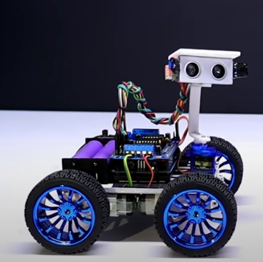
About Project
This Project is about “HUMAN FOLLOWING ROBOAT”.

Slide 4
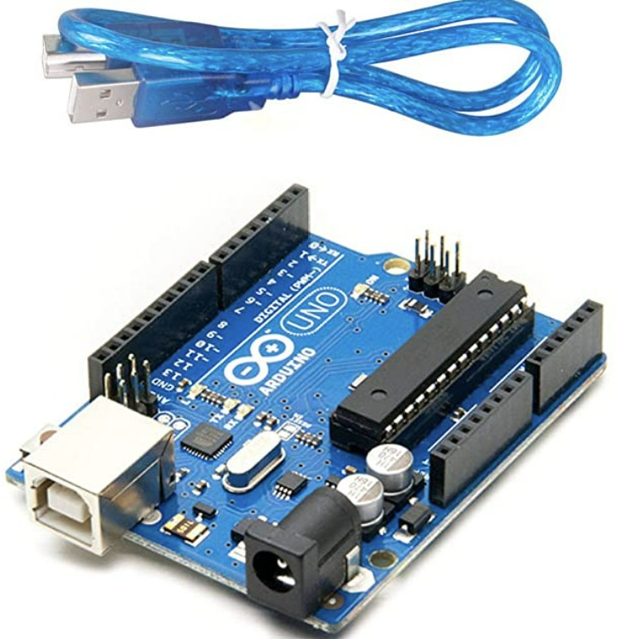
Material Required
Arduino UNO
Arduino is an open-source electronics platform based on easy-to-use hardware and software. Arduino boards are able to read inputs - light on a sensor, a finger on a button, or a Twitter message - and turn it into an output - activating a motor, turning on an LED, publishing something online.

Slide 5
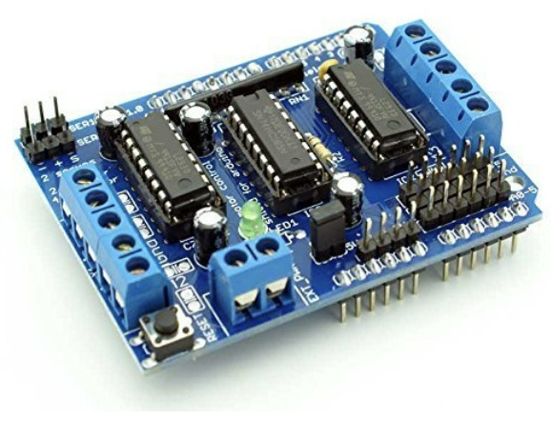
2.Motor Driver Shield
L293D shield is a driver board based on L293 IC, which can drive 4 DC motors and 2 stepper or Servo motors at the same time.
Image result for motor driver shield The Arduino Motor Shield allows you to easily control motor direction and speed using an Arduino. By allowing you to simply address Arduino pins, it makes it very simple to incorporate a motor into your project. It also allows you to be able to power a motor with a separate power supply of up to 12v.

Slide 6
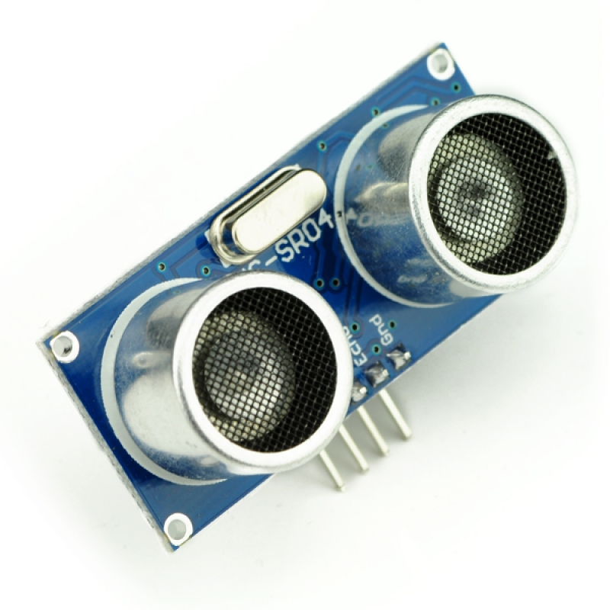
3.ULTRASONIC SENSOR
Ultrasonic Sensor
An ultrasonic sensor is an instrument that measures the distance to an object using ultrasonic sound waves.
An ultrasonic sensor uses a transducer to send and receive ultrasonic pulses that relay back information about an object's proximity.

Slide 7
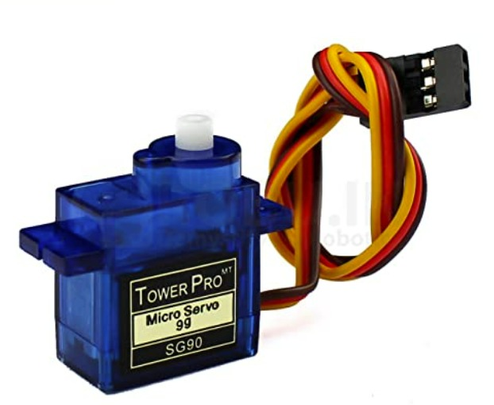
4. servo motor
A servomotor (or servo motor) is a rotary actuator or linear actuator that allows for precise control of angular or linear position, velocity and acceleration. It consists of a suitable motor coupled to a sensor for position feedback.

Slide 8
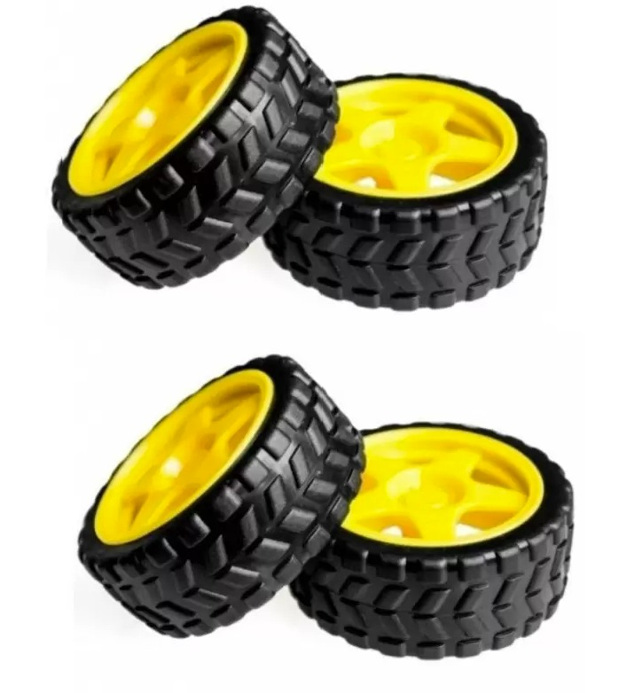
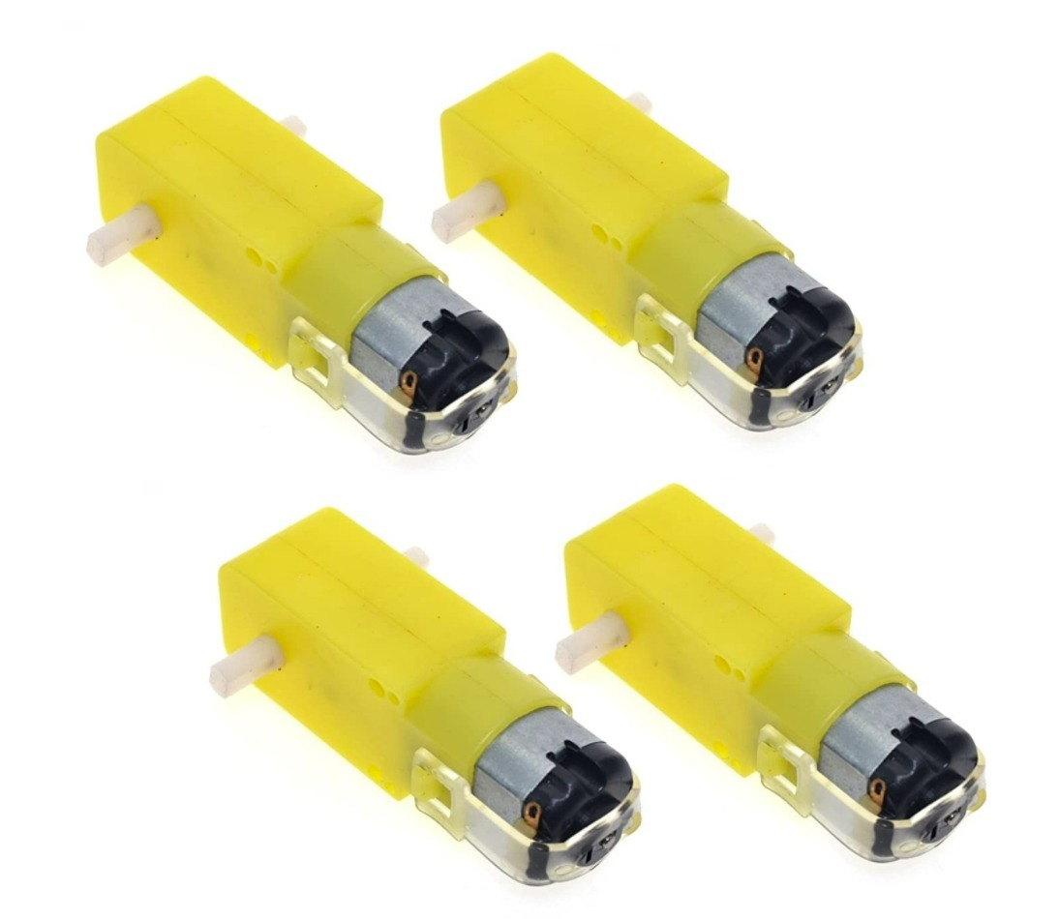
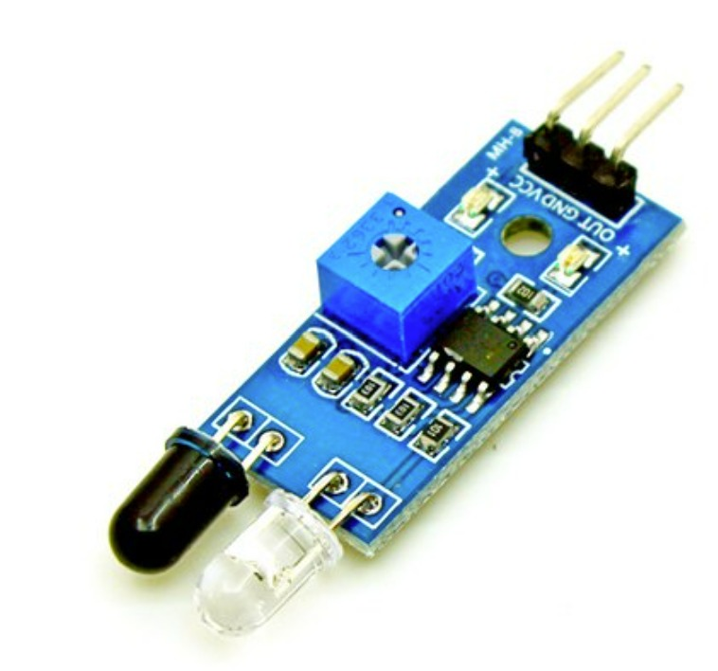
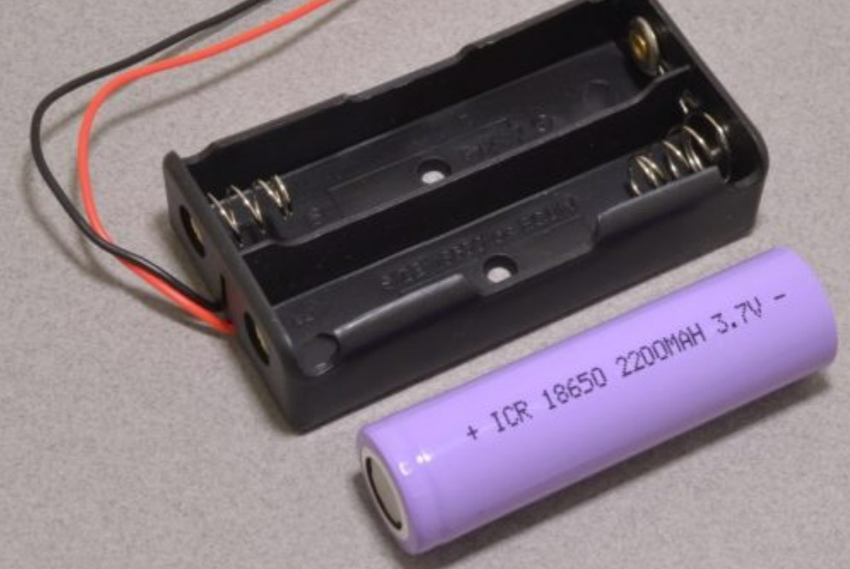
6.TT,GEAR MOTOR
5.WHEELS
8.18650 Battery Holder
7.IR SENSOR

Slide 9
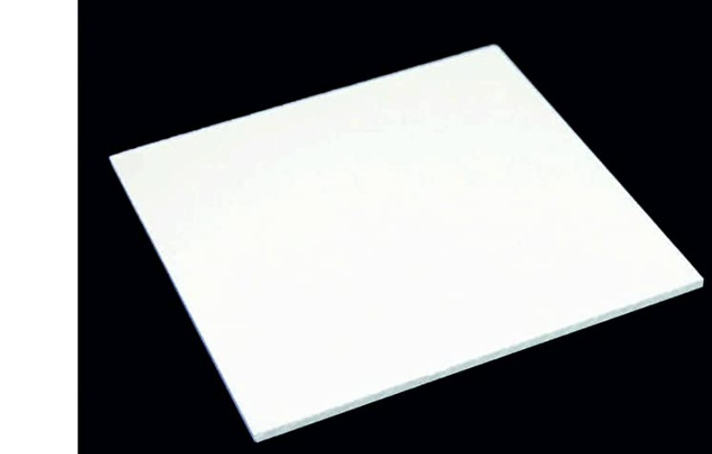
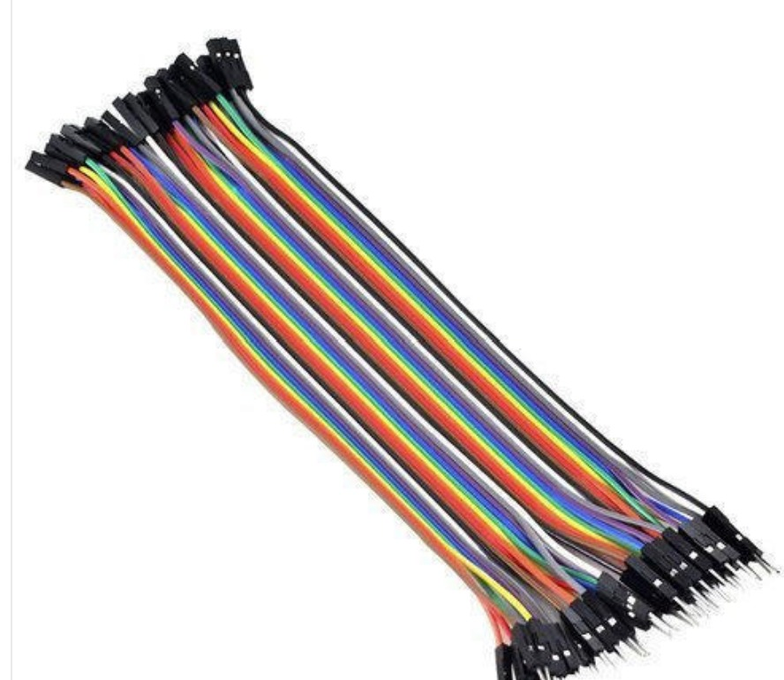
9.ARCYLIC SHEET
10.JUMPER WIRES

Slide 10
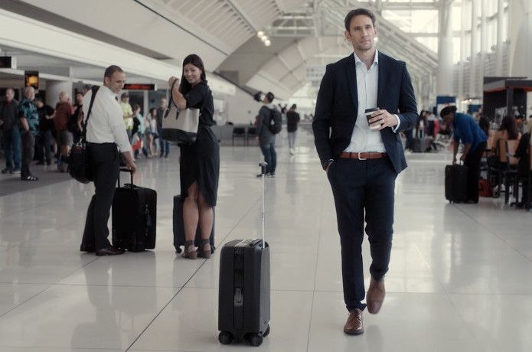
APPLICATIONS:-
***************HUMAN FOLLOWING LUGAGE**************

Slide 11
THANK YOU

